Slide 1
Intro to F#
Functional programming for the rest of us
Notes:
Hi and welcome to the backend portion of our code camp. As you know, we’re going to be looking at F# today, and specifically, learning how to do some cool things quite quickly and elegantly. I call this talk “functional programming for rest of us” because functional programming is sort of a reserved area of the programming world. The nerdiest of the programmer nerds (Seth?) are into it, and those espousing it are sort of these super headed math geeks.
The reality is functional programming has some extremely valuable features (which is largely why you see C# features coming in pretty much straight from F#)

Slide 2
Why F#?
Conciseness
Functional First
Expressive
Complete
It just takes less code to do the same thing in F# than it does in near every other .NET language.
No code noise like braces / brackets everywhere, and type inference keeps extra words out of there!
Notes:
A lot of the major value of F# is it’s ability to do more with less words.
I know that seems silly, but when you’re doing small simple things, which is what you should generally always be doing, saying it concisely allows for it to be more quickly read, and more quickly understood.

Slide 3
Why F#?
Conciseness
Functional First
Expressive
Complete
Writing “functional style” code allows for easier testing, and easier to read code.
A language built with that in mind is a lot better than retrofitting a style to a language built to be object-oriented.
Notes:
Writing elegant objects is always great, but exposes some rather nasty “design” problems, especially when you're talking about things like the “basic functions.”
Trying to fit something into a stateful pattern often times just creates crummy designs.
What “object” should you put a “square root of an integer, minus 6” or some other silly under the hood calculation? A class ending in ER or OR? No thank you… :)
In a functional language, there’s no problem. Name your module something reasonable as you need, and you’re writing perfectly elegant functional code!
That said, it’s a “functional first” language, not a functional-only language. If you need to do something in a procedural way, go ahead!

Slide 4
Why F#?
Conciseness
Functional First
Expressive
Complete
Functional languages can be pretty nasty to read. (Caml, LISP and Clojure to name a few.)
F# was designed to be QUICKLY read and quickly compiled, understood by both a person and the programmer.
Notes:
A lot of the major benefits to an expressive language is one meant to be written quickly, and read just as quickly.

Slide 5
Why F#?
Conciseness
Functional First
Expressive
Complete
It’s still .NET! All the framework goodness we know and love are all still there.
Wanna do procedural stuff, go right ahead, F# lets you do that! It’s got everything you’re used to and all the support too!
Notes:
F# is all .NET all the time, so you aren’t having to rebuild everything from scratch. You can use whatever libraries you like, EF if you want to, log4net, or whatever that you already know.

Slide 6
How do I start?
With a script!
HelloWorld.fsx
printfn "Hello World"
Notes:
Starting with F# means starting from a script. An FSX-file is a script file written in F#.
The first thing we’ll write is printfn “Hello World”

Slide 7
How do I start?
With a script!
HelloWorld.fsx
printfn "Hello World"
A function. Equivalent to Console.WriteLine (in C#)
Notes:
Printfn is a function call.

Slide 8
How do I start?
With a script!
HelloWorld.fsx
printfn "Hello World"
The parameter. Compare to Console.WriteLine(“Hello World”);
Notes:
The second object is the parameter.
Note: we’re already less code than C#. We’re already 14 characters more concise! #Winning

Slide 9
How do I start?
With a script!
HelloWorld.fsx
printfn "Hello World"
Altogether, we get our function result, a “unit”
Notes:
The unit result is similar to the “void”, except F# is functional, and so unlike C#, you can set something to that void.

Slide 10
How do I start?
With a script!
HelloWorld.fsx
let result = printfn "Hello World"
We have now assigned the variable “result” to the value “Unit”

Slide 11
What the heck is “let”
The let keyword is an assignment operator. It gives names to things.
Like values or results of functions. or functions themselves.
let fortyTwo = 42
let twentyEight = times_4 7
let squareAndAdd6To val = val * val + 6

Slide 12

Let Keyword : Unlocked

Slide 13
Tuples, triples, etc.
A tuple is a great way to quickly associate two or more pieces of data together.
let myFirstTuple = (5, 4) val myFirstTuple : int * int = (5, 4)
Notes:
Simple construction of a tuple

Slide 14
Tuples, triples, etc.
A tuple is a great way to quickly associate two or more pieces of data together.
let myFirstTuple = (5, “I’m all about that bass”) let firstItem, secondItem = myFirstTuple let anotherTuple = (item1, item2)
Notes:
Mixing types are no trouble.

Slide 15
Tuples, triples, etc.
A tuple is a great way to quickly associate two or more pieces of data together.
let myTriple = (5, [“this”;”is a list”], 1.41) let item1, _, item3 = myTriple
Notes:
Don’t intend to use the second element? Use the underscore character, and you never have to worry about it.

Slide 16
Tuples, triples, etc.
A tuple is a great way to quickly associate two or more pieces of data together.
let x = (45, 43) let y = (45, 43) let z = (x = y) // true!
Notes:
And equality works like you’d expect it to.

Slide 17
Tuples : Unlocked

Slide 18
Indenting and whitespace
Unlike many languages, whitespace MATTERS when writing in F# code.
let function argument = let function-scoped = 42 let another-scoped = 21 … let outer-scoped = “Steven U”
NOTE: 4 spaces imply a variable within the scope of the “function”.
Notes:
I find whitespace in C# to be very inconsistent. Properties without backing fields should be on one line. Linq statements have a funky structure, but not when in method groups.
Whitespace in F# allows me to understand the scope of something.

Slide 19
Indenting and whitespace
Unlike many languages, whitespace MATTERS when writing in F# code.
let function argument = let subfunction arg = let deeply-scoped = ... let outer = subfunction “StevenU”
Again, 4 spaces deeper show a variable within the scope of the “subfunction”.
Notes:
Or secondarily so

Slide 20
Indenting and whitespace
Unlike many languages, whitespace MATTERS when writing in F# code.
let function argument = let subfunction arg = let deeply-scoped = ... let outer = subfunction “StevenU”
And “subfunction” is callable within the scope of the parent.

Slide 21
Indenting and whitespace
Unlike many languages, whitespace MATTERS when writing in F# code.
let function argument = let subfunction arg = let deeply-scoped = ... let outer = subfunction “StevenU”
let broken = subfunction “No can do”
But ‘subfunction’ falls outside that scope, so is no longer callable.

Slide 22
Whitespace : Unlocked

Slide 23
Branching with ‘if’
Like many other programming languages, simple branching is done with an ‘if’ statement. Examples:
let greet name = let hr = System.DateTime.Now.Hour if hr < 12 then sprintf “Good morning %s!” name elif hr < 17 then sprintf “Good afternoon %s!” name else sprintf “Good evening, %s!” name
Notes:
I don’t think I’ve ever seen a language that didn’t have an “if”

Slide 24
If Keyword : Unlocked

Slide 25
Let’s try match expressions!
A match expression is a switch statement on steroids.
let greet name = match System.DateTime.Now.Hour with | hr when hr < 12 -> sprintf “Good morning %s!” name | hr when hr < 17 -> sprintf “Good afternoon %s!” name | _ -> sprintf “Good evening, %s!” name
Notes:
The statement itself looks pretty much like a plain jane switch statement.

Slide 26
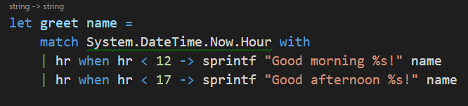
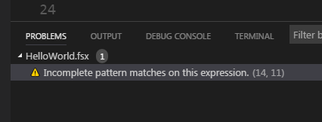
But these ones have (better) compiler help.
Example:
Notes:
The compiler can get fancy, knowing we are missing edge cases, bugs.

Slide 27
And can even match against structure.
let length list = let rec loop acc = match acc with | head::tail -> 1 + loop (tail) | [] -> 0
loop list
Notes:
A function name.

Slide 28
And can even match against structure.
let length list = let rec loop acc = match acc with | head::tail -> 1 + loop (tail) | [] -> 0
loop list
Notes:
Taking a list

Slide 29
And can even match against structure.
let length list = let rec loop acc = match acc with | head::tail -> 1 + loop (tail) | [] -> 0
loop list
Notes:
The “rec” keyword is new, and what it means is that “I’m defining a recursive function.”

Slide 30
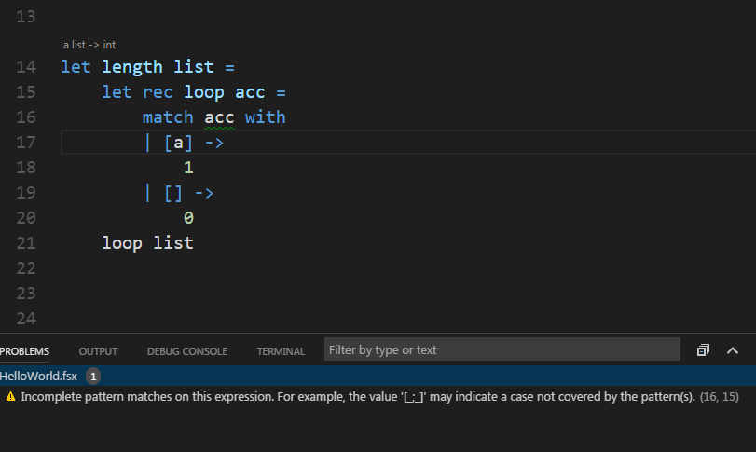
Remember that nifty compiler help?
Notes:
The compiler can get fancy, knowing we are missing edge cases, bugs.

Slide 31
Match expressions: Unlocked

Slide 32
Lots of looping
Functional languages offer many many many ways of looping over things. Examples: The traditional For loop.
let printNumbers minimum maximum = for number in minimum..maximum do printfn “Printing %i” number
Notes:
Here we start with a printNumbers call taking a minimum and maximum parameter.

Slide 33
Other ways
Functional languages offer many many many ways of looping over things. Examples: Iterating over a list.
let printNumber floatVal = printfn "Printing %f!" floatVal
let printNumbers (minimum:float) (maximum:float) = List.iter printNumber [minimum..0.45..maximum]
Notes:
Here, we define a function for what was in the body of the loop, namely the printNumber function. Then, we pass that function to the List.iter function, finally, passing in the list of ranged values we want iterated over.

Slide 34
Other ways
Functional languages offer many many many ways of looping over things. Examples: Iterating over a list.
let printNumber floatVal = printfn "Printing %f!" floatVal
let printNumbers (minimum:float) (maximum:float) = List.iter printNumber [minimum..0.45..maximum]
Notes:
Here, we define a function for what was in the body of the loop, namely the printNumber function. Then, we pass that function to the List.iter function, finally, passing in the list of ranged values we want iterated over.

Slide 35
Using pipelining
Functional languages offer many many many ways of looping over things. Examples: Iterating over a list.
let printNumbers (minimum:float) (maximum:float) = [minimum..0.45..maximum] |> List.iter printNumber
Notes:
One thing you’ll see a lot in F# is pipelined expressions. Pipelining is a common pattern for list operations, effectively saying “take the item on the left of the pipeline, and pass it as the “last parameter” on the right side of the pipeline

Slide 36
Using pipelining
Functional languages offer many many many ways of looping over things. Examples: Iterating over a list, after filtering it.
let printNumbers (minimum:float) (maximum:float) = [minimum..0.45..maximum] |> List.filter (fun x -> x%1.0 = 0.00) |> List.iter printNumber
Notes:
And naturally you can combine them. In this example, we’ve filtered the initial list and passed the resulting list into the second one. AKA, a where clause.

Slide 37
Lists and Pipelines : Unlocked

Slide 38
Simple Types
A type works similarly to a tuple, but records have named properties, so you can access what you need by property name.
type Person = { FirstName : string LastName : string }
Notes:
Declaring a type. This declares a type called Person.

Slide 39
Simple Types
A type works similarly to a tuple, but records have named properties, so you can access what you need by property name.
type Person = { FirstName : string LastName : string } let cb = { FirstName = "Christopher"; LastName = "Brown" }
Notes:
Creating an instance of a person.

Slide 40
Simple Types
A type works similarly to a tuple, but records have named properties, so you can access what you need by property name.
let renderPerson person = printfn “%s %s” person.FirstName person.LastName
Notes:
Using a person.

Slide 41
Simple Types
A type works similarly to a tuple, but records have named properties, so you can access what you need by property name.
let x = { FirstName = "Christopher"; LastName = "Brown" } let y = { FirstName = "Christopher"; LastName = "Brown" } let z = (x = y) // true! (yes, even with types.)
Notes:
Equality works like you’d expect it to, unlike C#.

Slide 42
Simple Types
A type works similarly to a tuple, but records have named properties, so you can access what you need by property name.
let dad = { FirstName = "Christopher"; LastName = "Brown" } let zoe = { dad with FirstName = "Zoe" }
Notes:
Cloning is quick.

Slide 43
Simple Types
A type works similarly to a tuple, but records have named properties, so you can access what you need by property name.
type Person = { FirstName : string ; LastName : string; Parent : option<Person> } let janet = { FirstName= "Janet"; LastName = "Mundell"; Parent = None}
let cb = { FirstName = "Christopher"; LastName = "Brown"; Parent = Some janet }
let sarah = { cb with FirstName = "Sarah" } // deepcopy
Notes:
Deep cloning is just as easy!

Slide 44
A word about Options
An option type is the functional way of optional values to a type.
type Person = { FirstName : string; LastName : string; parent : option<Person> }
Notes:
Fundamentally, this allows for you to deal with the “this item has a value or does not.”

Slide 45
A word about Options
An option type is the functional way of optional values to a type.
let janet = { FirstName= "Janet"; LastName = "Mundell"; Parent = None}
This implies there is no known value for that object.

Slide 46
A word about Options
An option type is the functional way of optional values to a type.
let janet = { FirstName= "Janet"; LastName = "Mundell"; Parent = None}
let cb = { FirstName = "Christopher"; LastName = "Brown"; Parent = Some janet }
This implies there is a value for that object.

Slide 47
How is this not just null?
Fundamentally it’s the way the compiler works.
type Person = { FirstName : string; LastName : string; parent : option<Person> }
A person != an Option<person> In OO languages with default behavior, it is.

Slide 48
Record Types (and Options) : Unlocked

Slide 49
Union Types - Enums, with an attitude
A Union type works similarly to an enum.
type Shape = | Circle | Square | Rectangle
Notes:
Declaring a type that works similarly to an enumeration.

Slide 50
Union Types - Enums, with an attitude
A Union type works similarly to an enum, but better!
type Shape = | Circle of Radius : float | Square of SideLength : float | Rectangle of LongSide : float * ShortSide : float
Notes:
The closest equivalent is basically an abstract base class, and you add properties as you need them.

Slide 51
Union Types - Enums, with an attitude
A Union type works similarly to an enum, but better!
type Shape = | Circle of Radius : float | Square of SideLength : float | Rectangle of LongSide : float * ShortSide : float | Line
Notes:
Or not.

Slide 52
Union Types - Enums, with an attitude
Naturally, they work well with match statements!
let area shape = match shape with | Circle (r) -> System.Math.PI * r * r | Square (sl) -> sl * sl | Rectangle (ls, ss) -> ls * ss
Notes:
Matching is handy against unions.

Slide 53
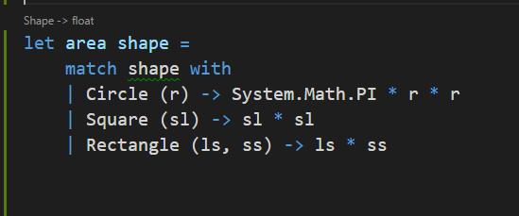
Union Types - Enums, with an attitude
Naturally, they work well with match statements!
Notes:
Or not.

Slide 54
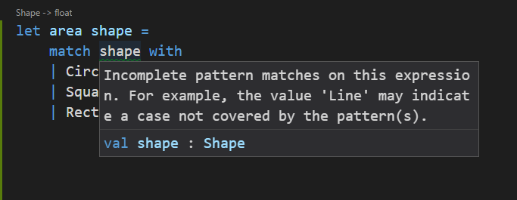
Union Types - Enums, with an attitude
Naturally, they work well with match statements!
Notes:
Or not.

Slide 55
Union Types - Enums, with an attitude
Naturally, they work well with match statements!
let area shape = match shape with | Circle (r) -> System.Math.PI * r * r | Square (sl) -> sl * sl | Rectangle (ls, ss) -> ls * ss | Line -> 0.0
Notes:
Or not.

Slide 56
Union Types : Unlocked

Slide 57
Type Providers - CSV data
My file: SomeDataFile.csv
Sample Contents: Account,Buy/Sell,Shares,Symbol,Average Price,Versus Purchase,Contra,Exchange,Solicited,As Of Date,Settle Date,SType 60257030,BY,75,15135B101,76.99,,993105,,N,5/2/2017,5/5/2017, 60257030,BY,286,22160K105,178.59,,993105,,N,5/2/2017,5/5/2017, 60257030,BY,257,29272W109,57.47,,993105,,N,5/2/2017,5/5/2017, 60257030,BY,7779,35906A108,1.93,,993105,,N,5/2/2017,5/5/2017, 60257030,BY,118,45337C102,123.71,,993105,,N,5/2/2017,5/5/2017,

Slide 58
Type Providers - CSV data
#r @“FSharp.Data.dll” // reference the dll. open FSharp.Data type FirstClear = CsvTypeProvider<“Path/To/SampleDataFile.csv”>
FirstClear.GetSample()
let data = FirstClear.Load(“Path/To/SomeDataFile.csv”)

Slide 59
Type Providers - CSV data
...
let data = FirstClear.Load(“Path/To/SomeDataFile.csv”) let firstRow = data.Rows |> seq.Head firstRow.

Slide 60
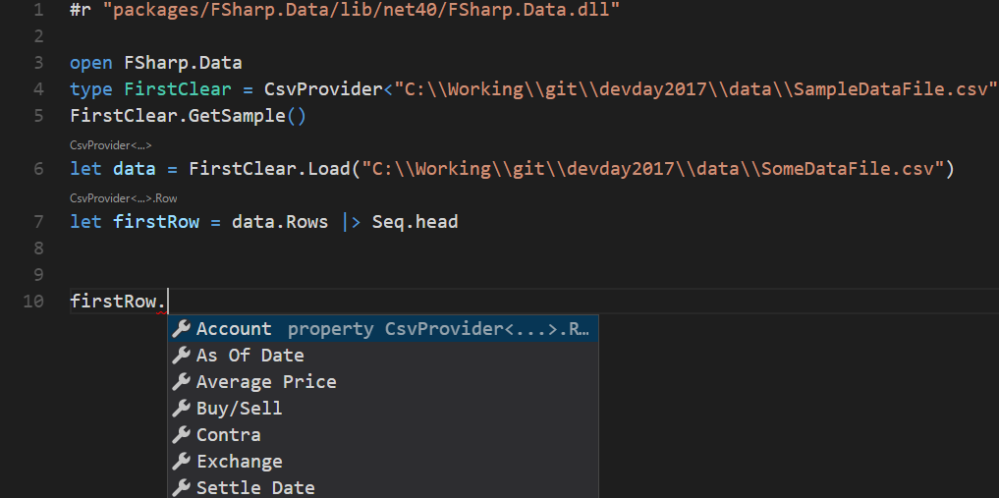
Type Providers - CSV data

Slide 61

Other formats - FSharp.Data
Out of the box
JSON Give it a JSON source, and you can just magically work with what’s available.
XML Ditto
CSV I just showed you this.
HTML Yep, even HTML tables.
WorldBank (a JSON derivative)

Slide 62
FSharp.Data.SqlClient
Yup. Even the functional nerds have heard of Sql Server.

Slide 63
Type Providers : Unlocked

Slide 64
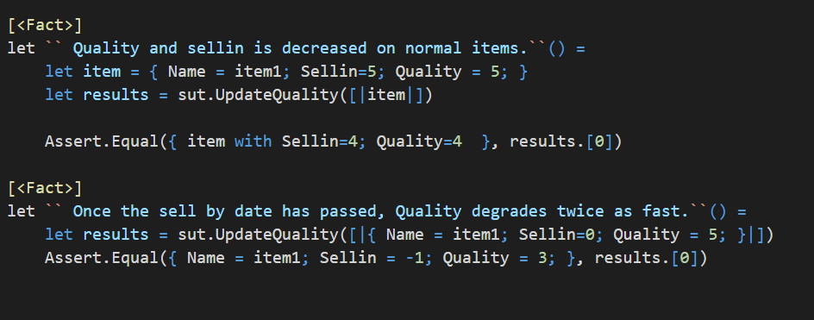
Hello, we’re a TDD shop. What about testing?
The Good
You have a REPL.
All the xUnit / NUnit frameworks work just as they did before.
F# tests can be more self documenting.
Much more tools out there to support property based testing.
Notes:
Naturally, testing is a big part of what we want to do here.

Slide 65
Hello, we’re a TDD shop. What about testing?
All the xUnit / NUnit frameworks work just as they did before.
F# tests are more self documenting.
Much more tools out there to support property based testing.
You have a REPL
Notes:
For now, focus on exploring the language through scripting. We’ll attack formal TDD when we’re compiling dlls and exes.

Slide 66
Hello, we’re a TDD shop. What about testing?
The Plan For CodeCamp AF Explore with the REPL for now. Expect testing with F# to come in brown bags later.

Slide 67
Tools you want
Visual Studio Code * Ionide-fsharp * Ionide-FAKE * Ionide-paket
Visual Studio 2013/2015 * F# Power Tools plugin * F# Interactive Intellisense plugin. Visual Studio 2017 * No plugins required * You WILL have to tell the installer to put it there for you (not on by default.)
Notes:
Let’s talk about actually

Slide 68
Fancy F# Tools the community just gives ya
FSharp.Data You’ll get to play with this. SUAVE Web host to the stars. FSharp.Charting Quick charts from F#. FAKE Tool to write build scripts in the same language the project is! PAKET A package manager that’s aware of dependencies, and expects you to be too.
Notes:
Let’s talk about actually

Slide 69
Resources
http://fsharp.org/ http://fsharpforfunandprofit.com/ https://en.wikibooks.org/wiki/F_Sharp_Programming https://suave.io/index.html http://fsharp.github.io/FSharp.Data/ https://fslab.org/FSharp.Charting/ https://docs.microsoft.com/en-us/dotnet/articles/fsharp/language-reference/ This Demo: https://github.com/cmbrown1598/fsDemo

